Slide 1
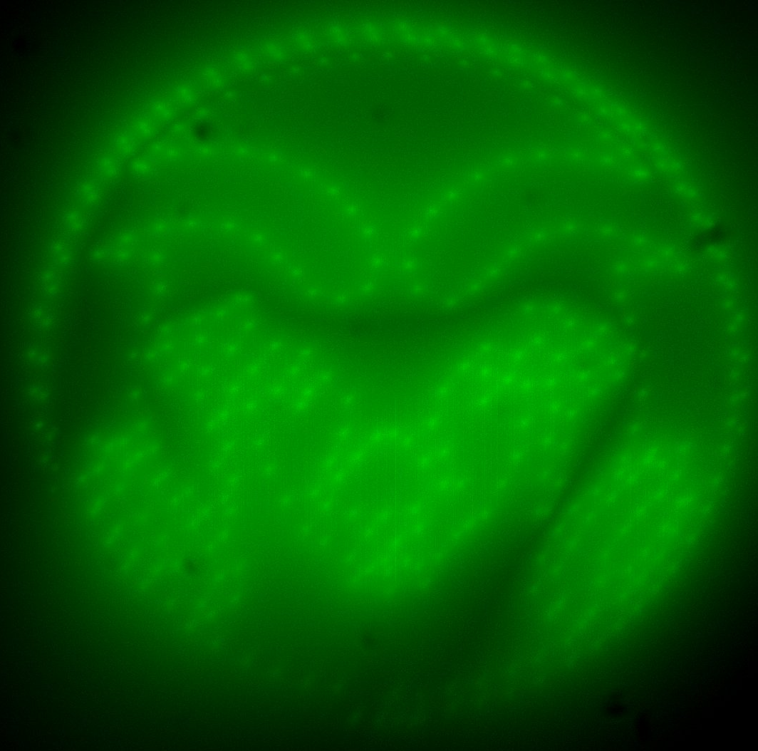
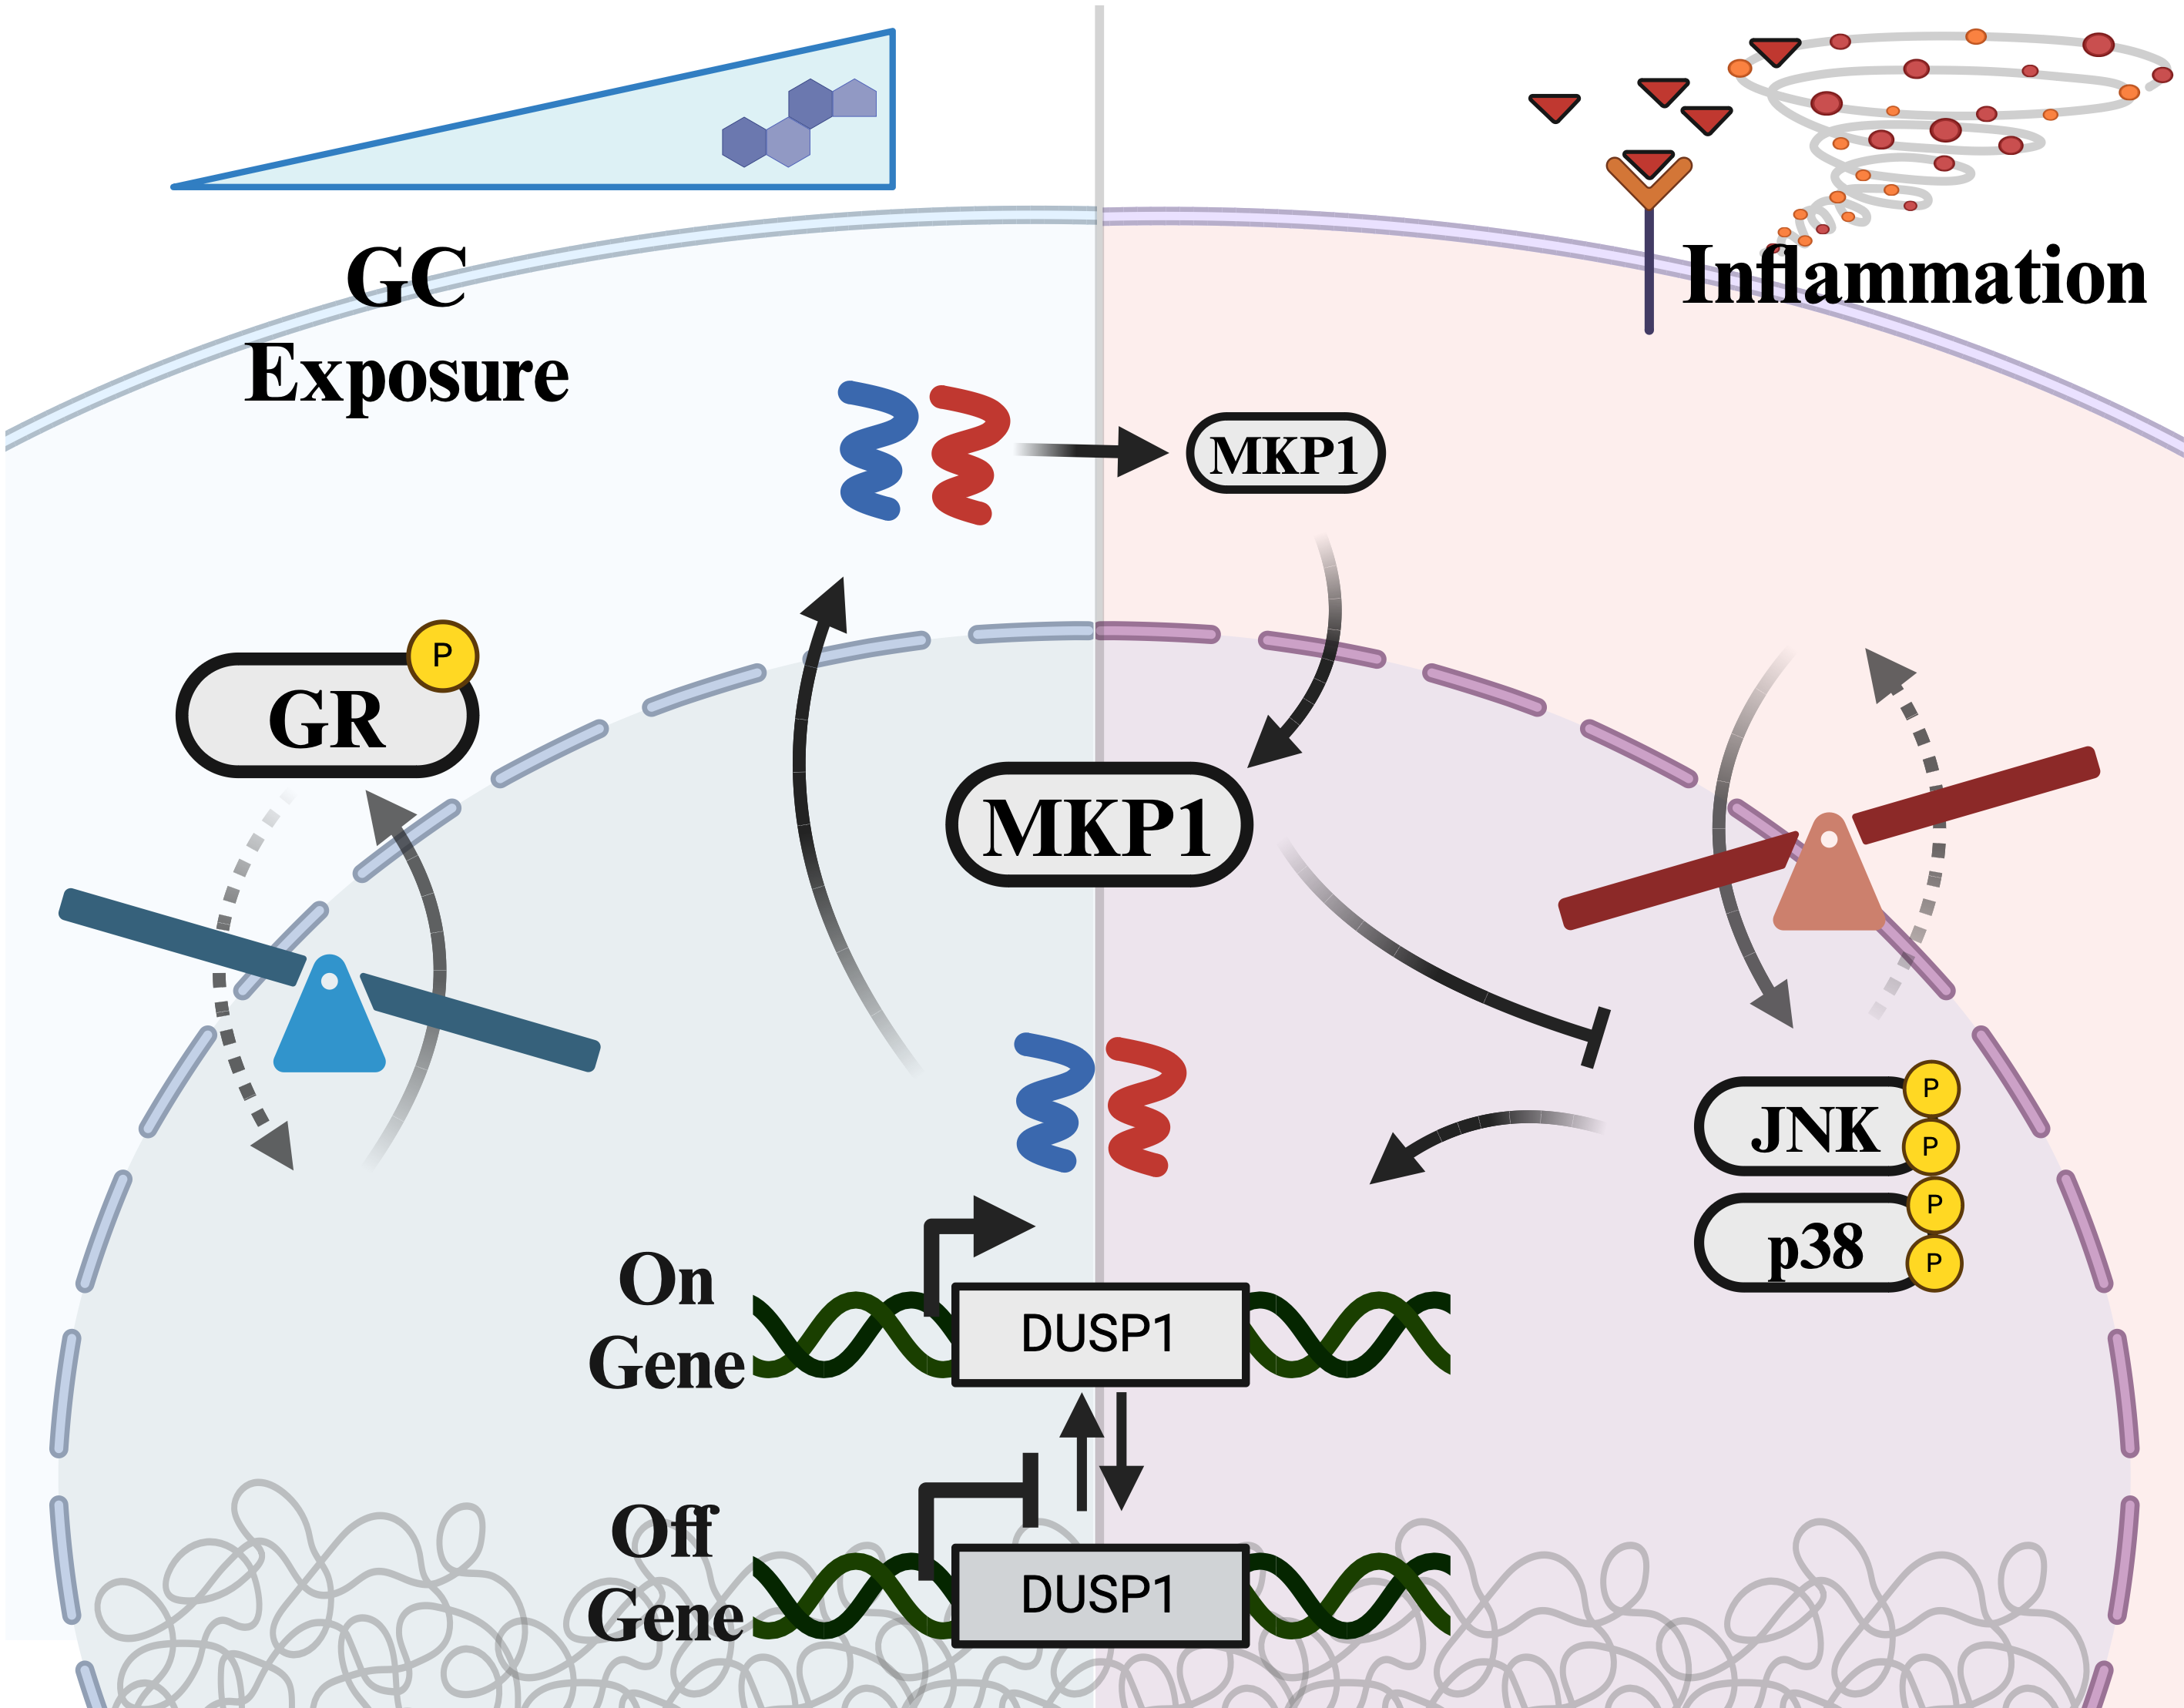
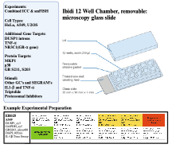
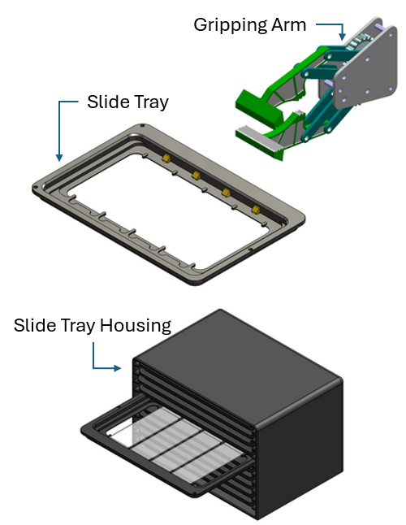
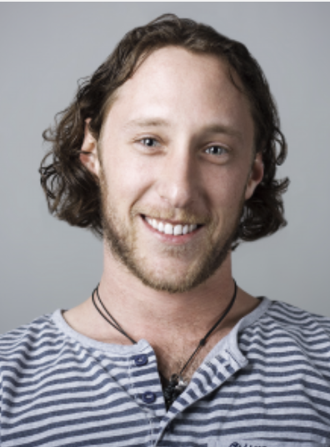
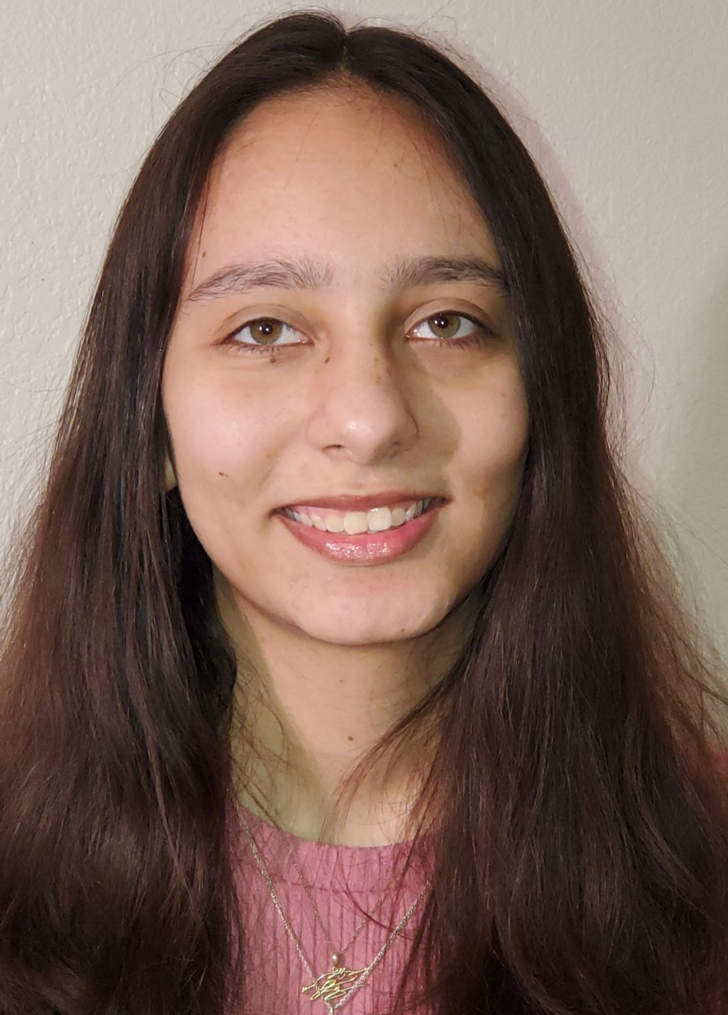
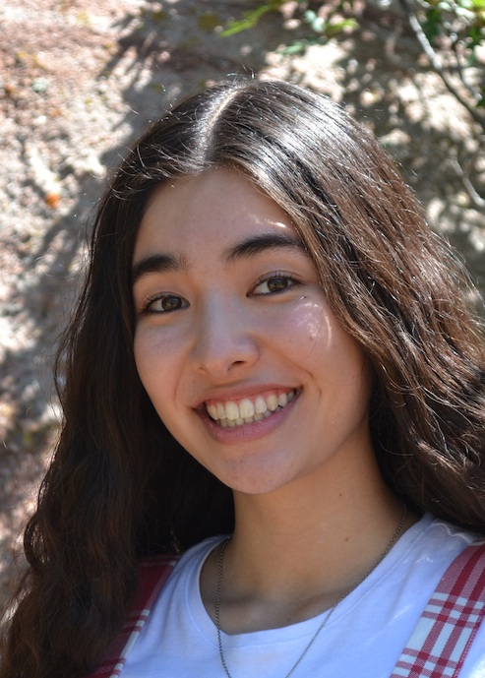
Extending throughput of Single-Cell Experiments
MKP1/p38 & GR Crosstalk and Dynamics
Automated Slide Handling
Original design
(12 time points)
FIM design
(3 time points)
Intensity
Eric Ron
Jack Forman
Isabelle Lemma
Alex David
Emika Buschow
Notes:
Describe Expt lab projects — 12 well plates multiple cells, additional genes and cell lines, GR-activated genes, Sr Design

Slide 2
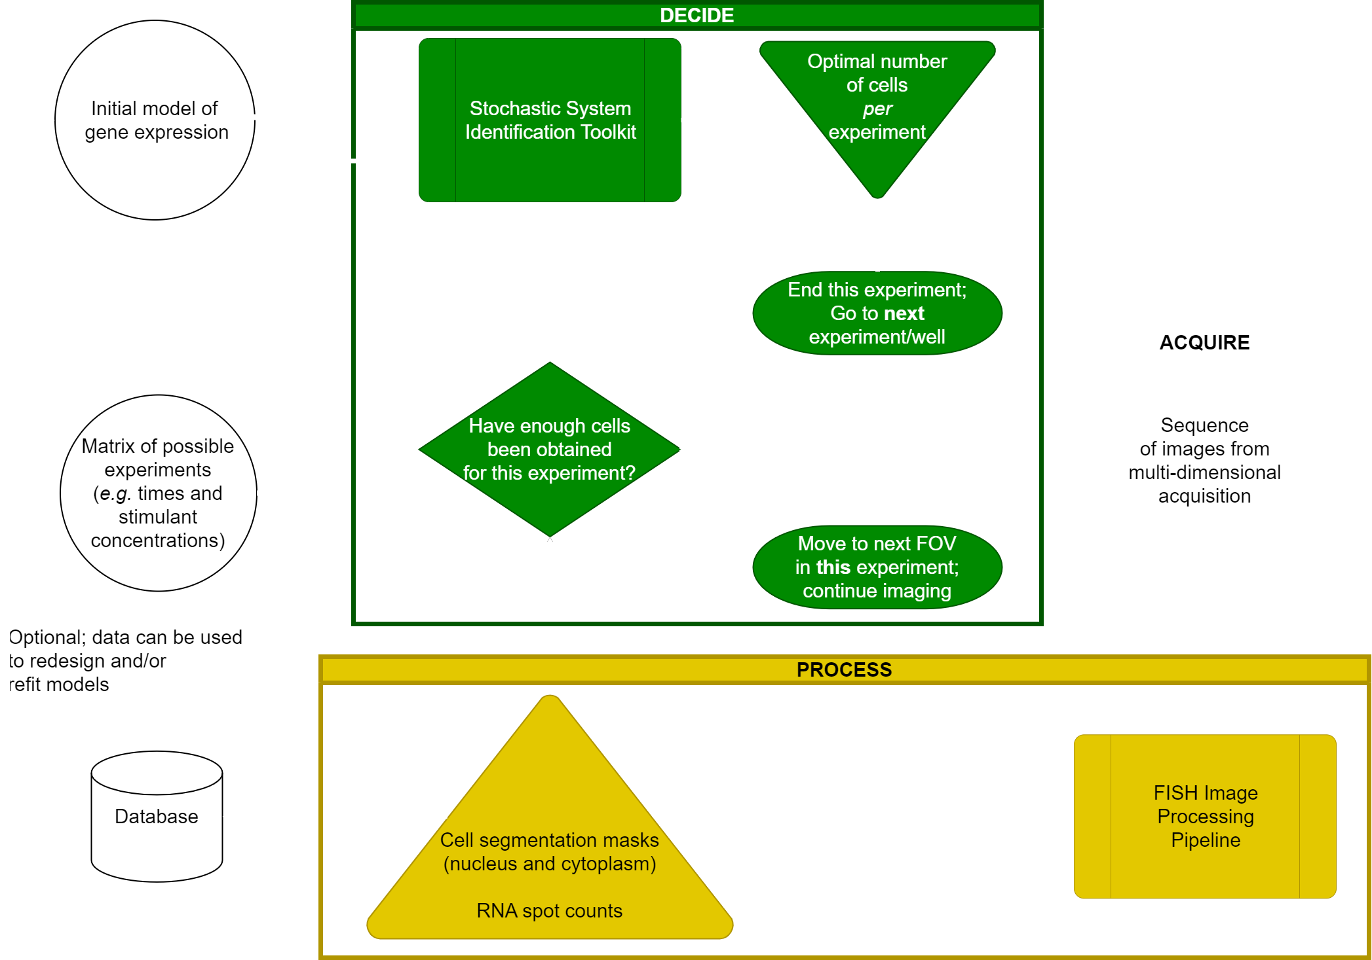
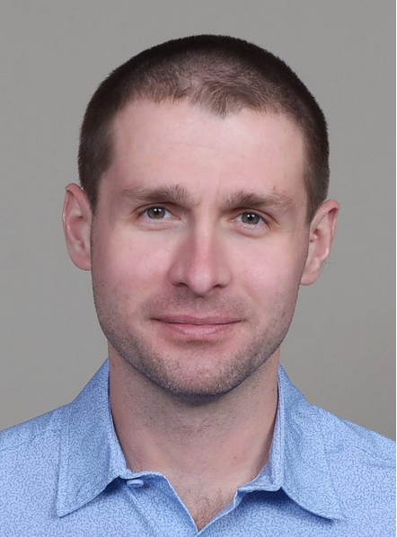
Automated Microscopy Acquisition, Processing, and Decision Pipeline
Imaging Workflow: Example: Tiling with Cell-Quota-Based FOV Selection
Original design
(12 time points)
FIM design
(3 time points)
Intensity
Dmitri Svetlov
Jack Forman
Isabelle Lemma
Notes:
Describe Dmitri and Jack’s projects — automated microscopy and image analyses

Slide 3
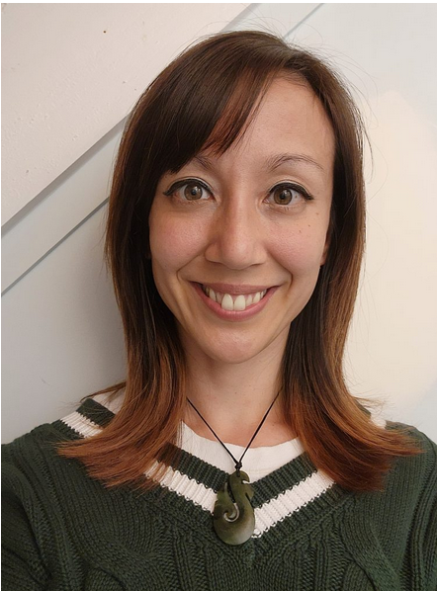
Testing and improving sequential model inference procedures despite probabilistic image distortions
PDOs for data distorted by:
Shorter exposure times
Lower microscope resolution
More efficient image processing routines
Suboptimal laser intensities
Different fluorophores
Different numbers of cell passages before experiment
Cheaper microscope
Different cell types
Lower drug concentrations
Fewer sampling times
Photobleaching
Original design
(12 time points)
FIM design
(3 time points)
Intensity
Alex Popinga
Notes:
Describe Alex’s projects — determination of different PDOs.

Slide 4
Conclusions and Future Directions
Original design
(12 time points)
FIM design
(3 time points)
Intensity
Alex Popinga
Dmitri Svetlov
Isabelle Lemma
Notes:
Describe Alex’s projects — determination of different PDOs.

